Slide 1
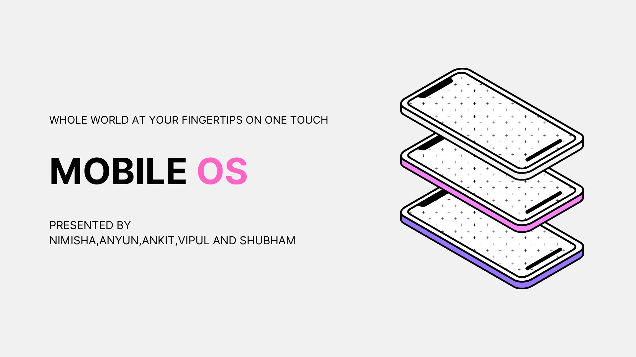

Slide 2
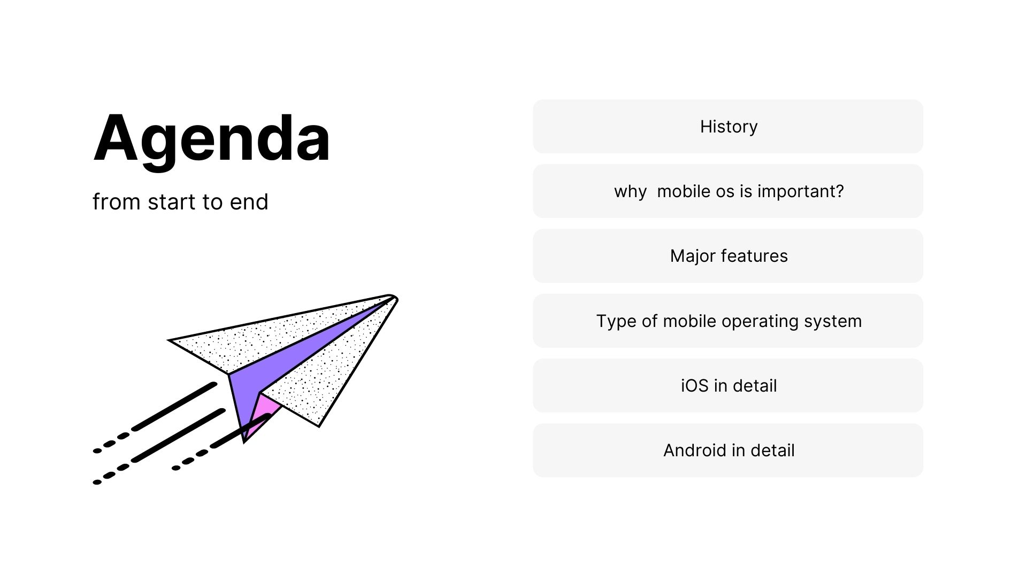

Slide 3
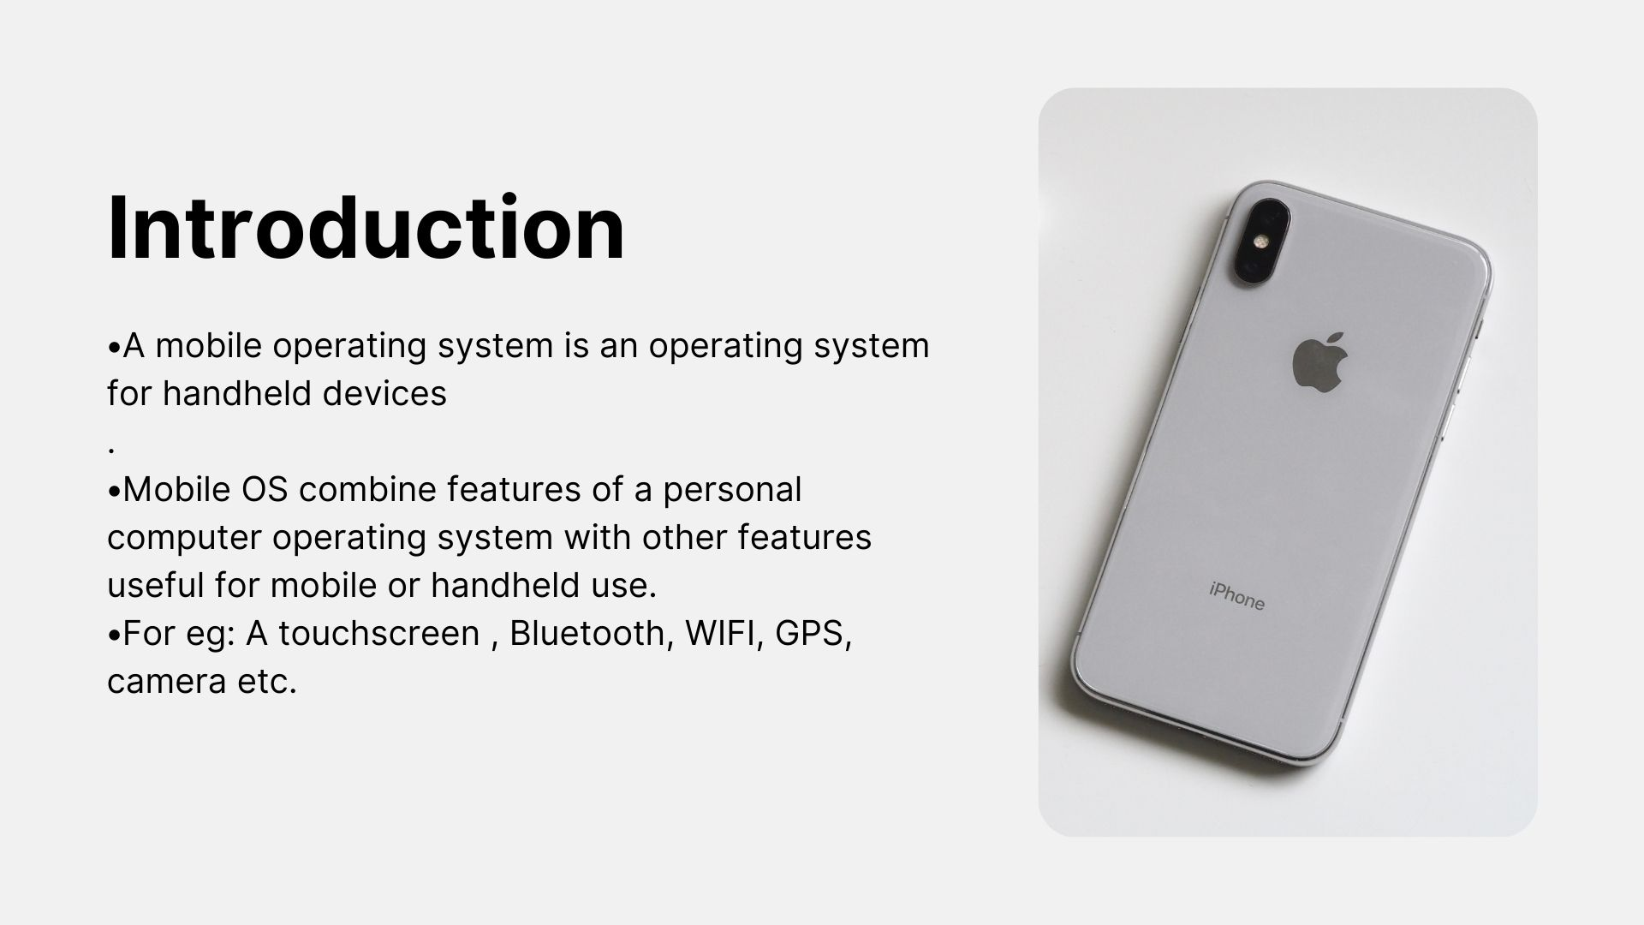

Slide 4
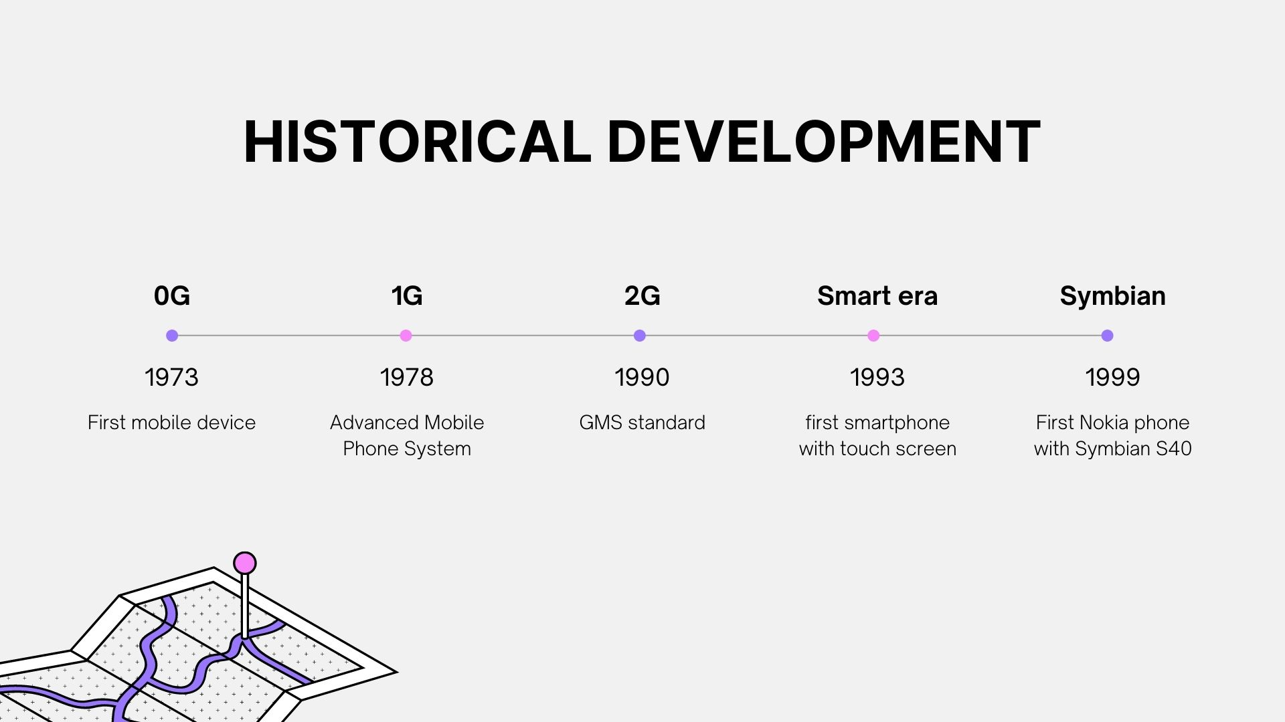

Slide 5
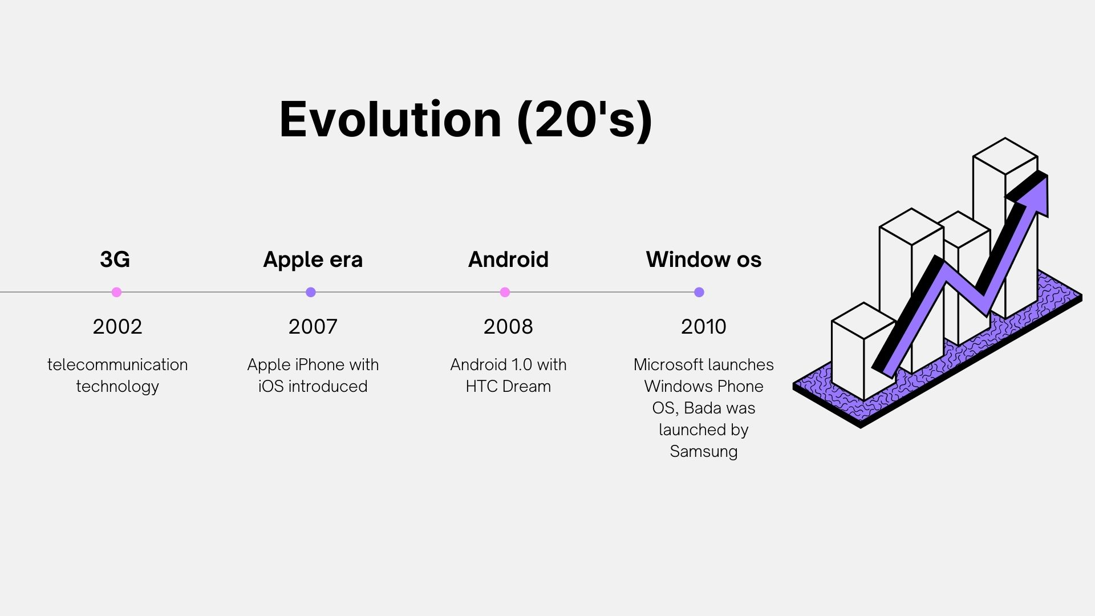

Slide 6
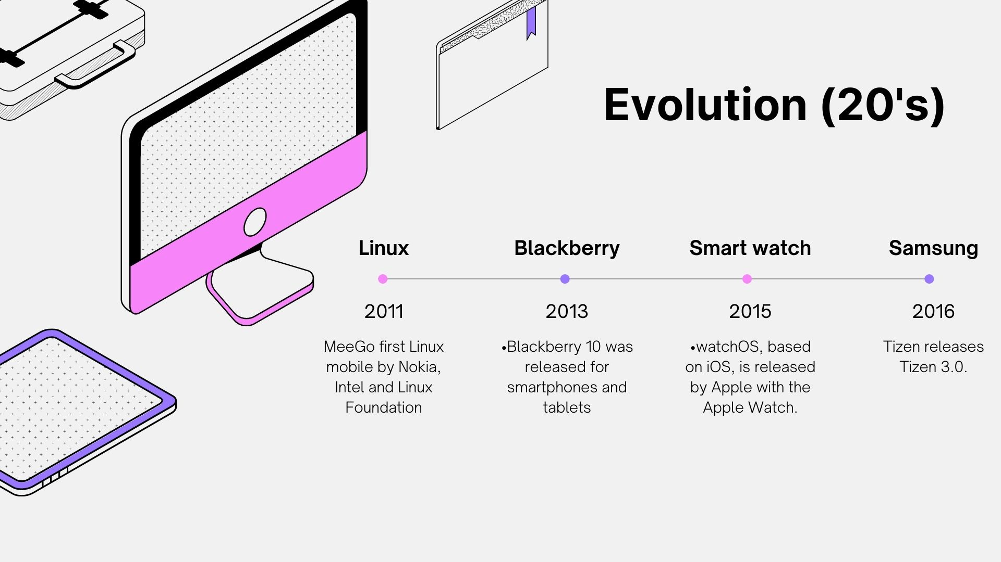

Slide 7
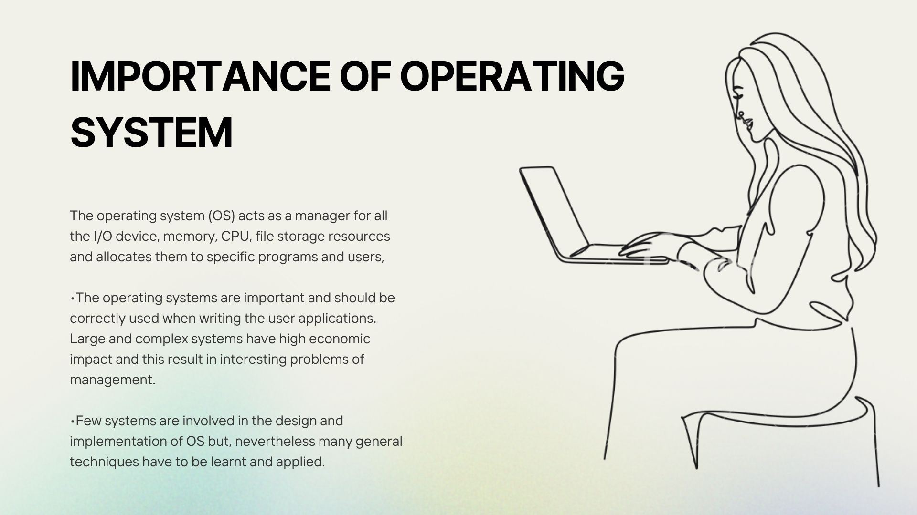

Slide 8
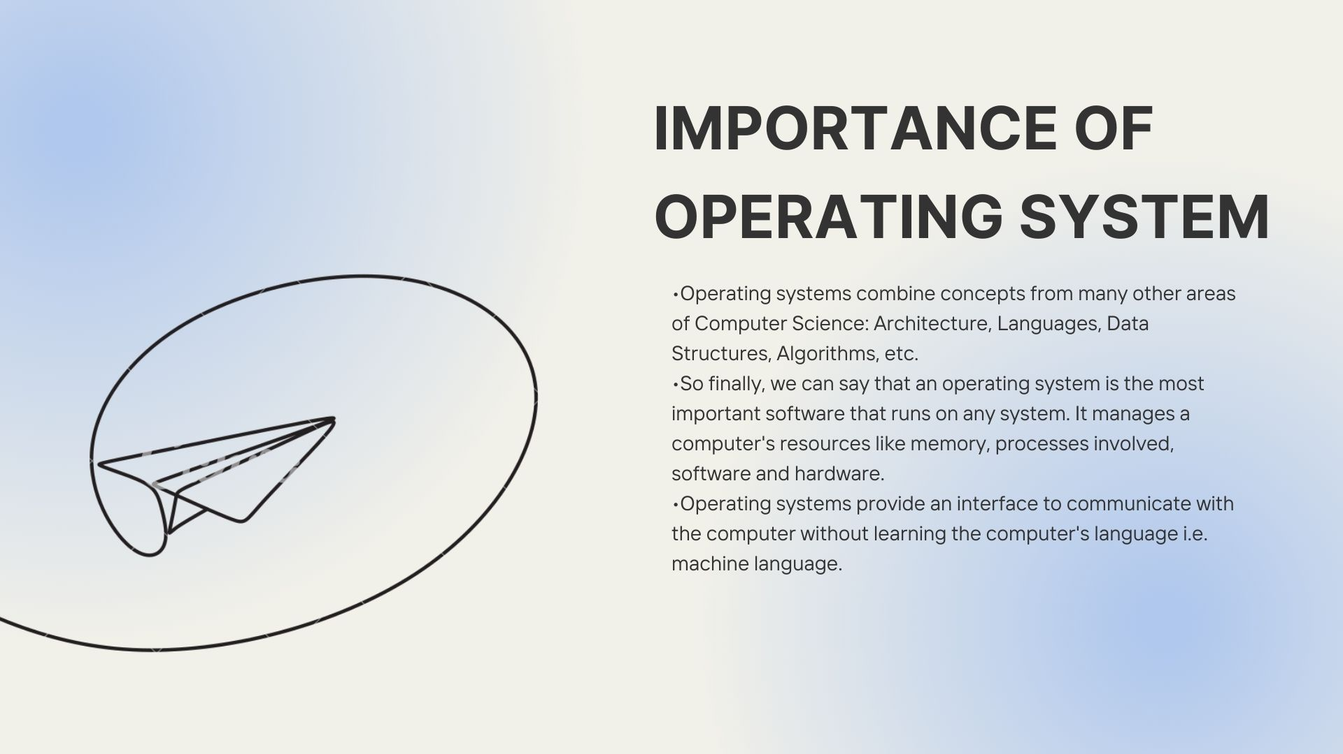

Slide 9
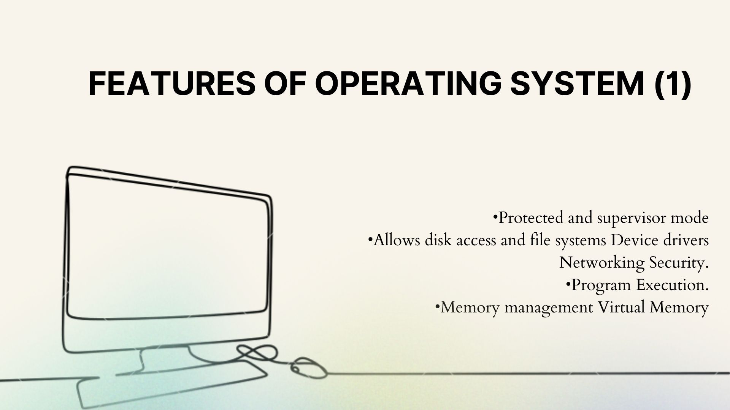

Slide 10
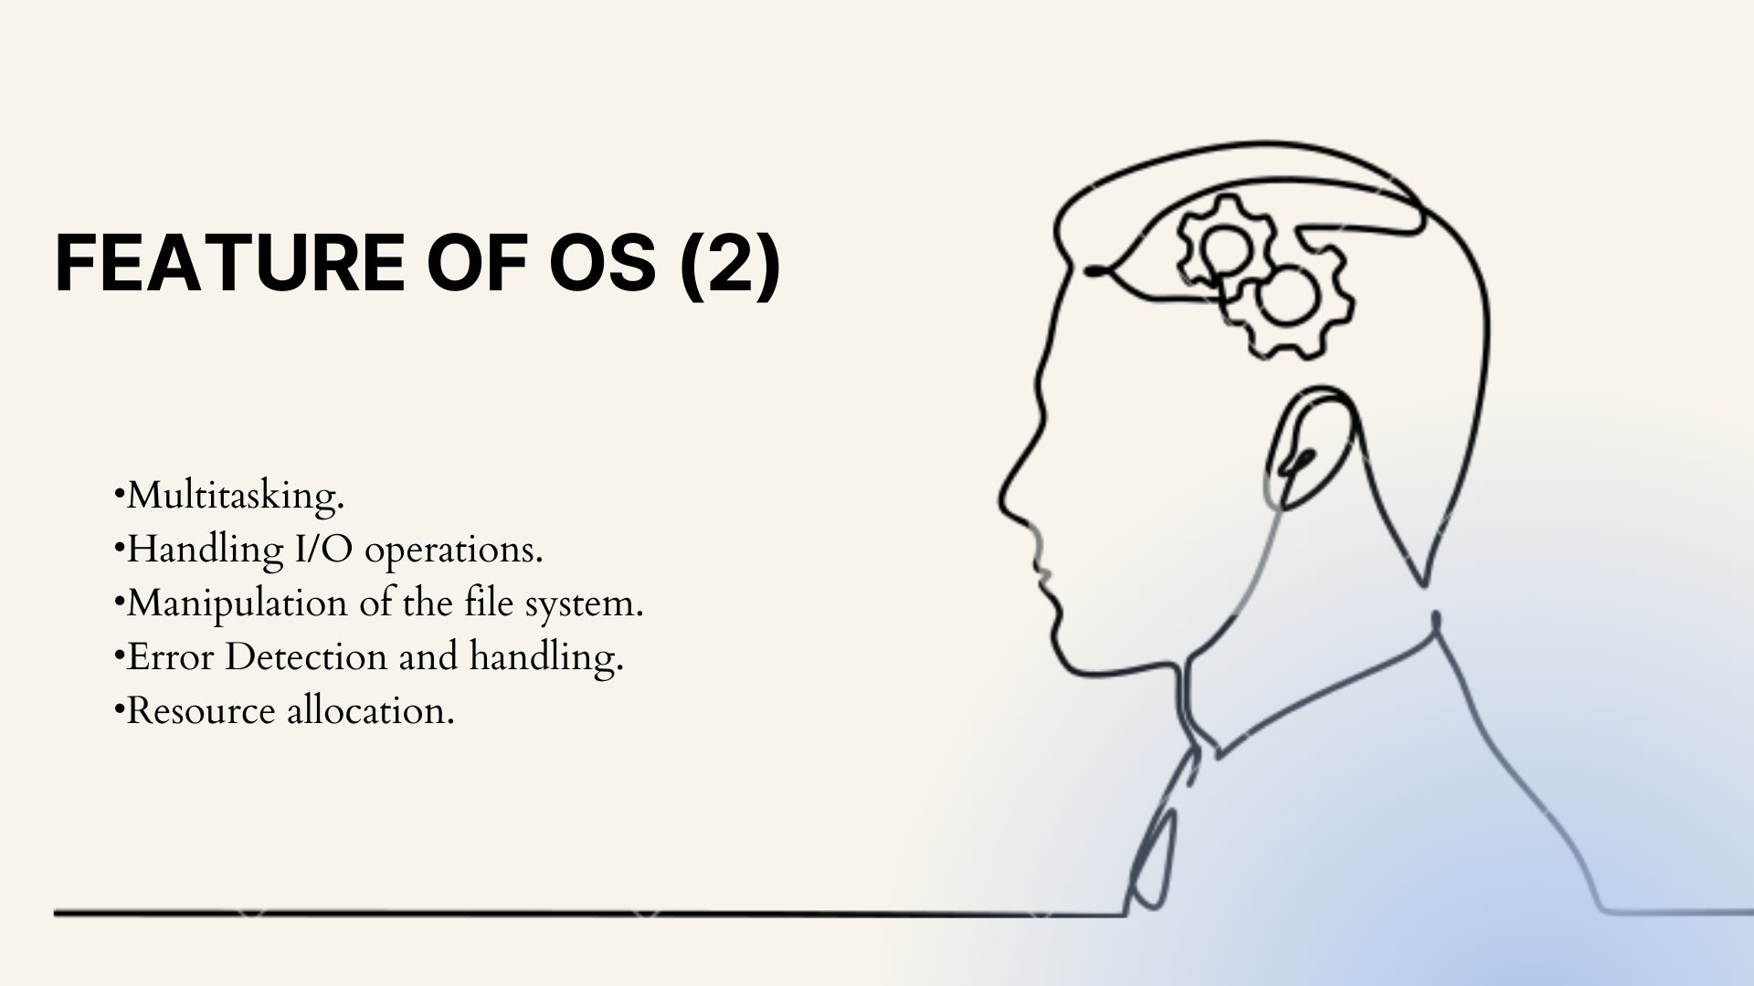

Slide 11
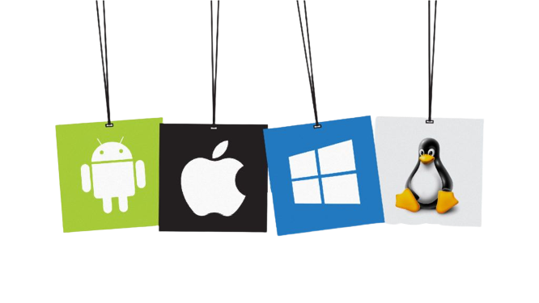
Types of Operating System in Mobile ?
Window phone OS
Symbian
BlackBerry
Samsung (Bada)
iOS
Android

Slide 12
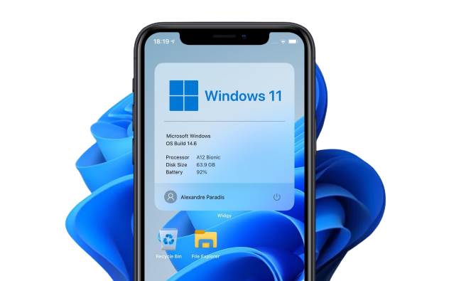
Window Phone OS?
Developed by : Microsoft
First Launch : October 2010
Windows Phone introduced a new design language, previously called Metro UI.

Slide 13
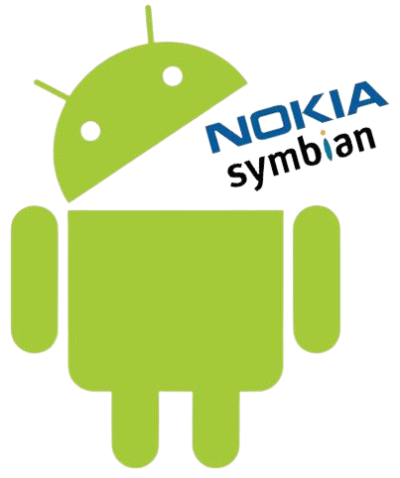
Symbian OS?
Developed by : Symbian Ltd.
First Launch : June 1997
Symbian was the leading smartphone platform up from 2003 up until 2010.
Major issue : apps written for one of these platforms were not compatible with the other directly.

Slide 14
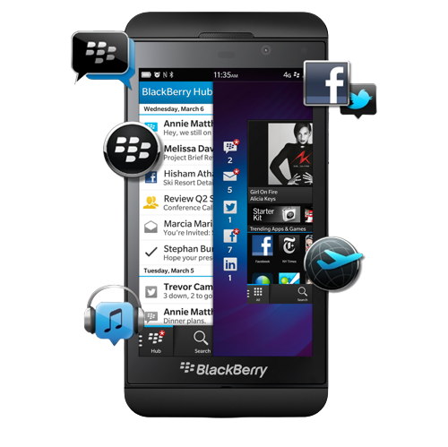
Blackberry OS?
Developed by : BlackBerry
First Launch : January 1999
The BlackBerry OS is designed for smartphone environments and is best known for its robust support for push Internet email.

Slide 15
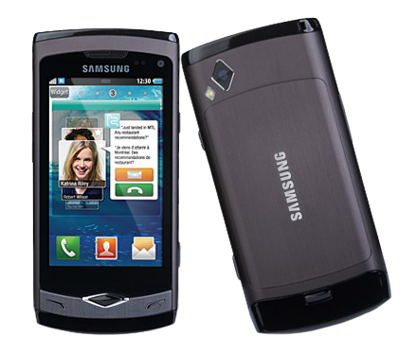
Samsung (bada) OS?
Developed by : Samsung
First Launch : 2010
It supports a number of advanced smartphone features, including multitouch, sensors, Flash, 3-D graphics, enhanced user interfaces and an application download source.

Slide 16
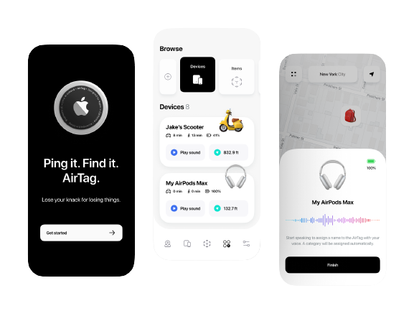
Apple iOS ?
Developed by=> Apple
Developed in=> 2007
Written in=> C / C++ / Objective-C/ Swift
Latest version=> iOS 15.5
launched=> May 16, 2022

Slide 17
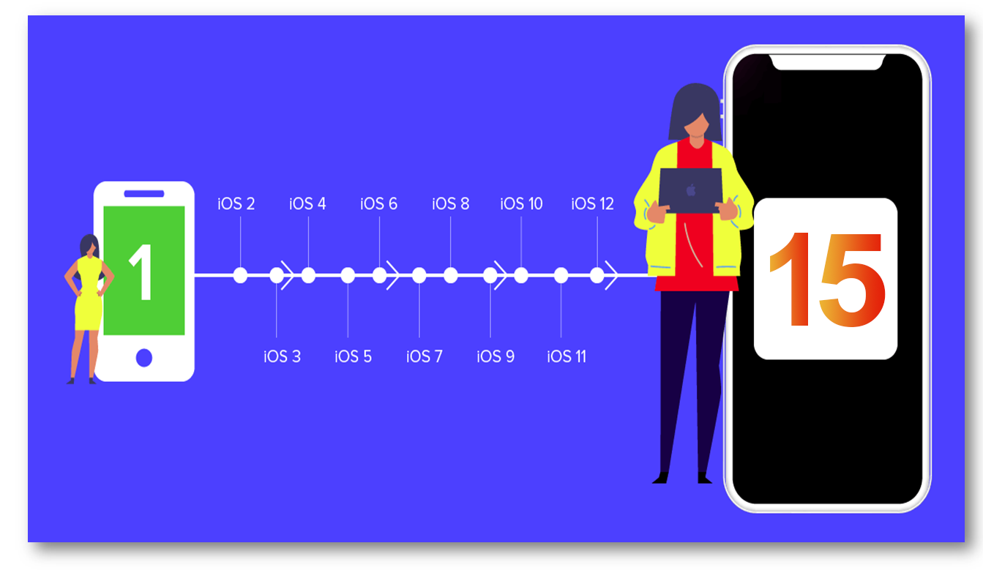
Evolution of iOS

Slide 18
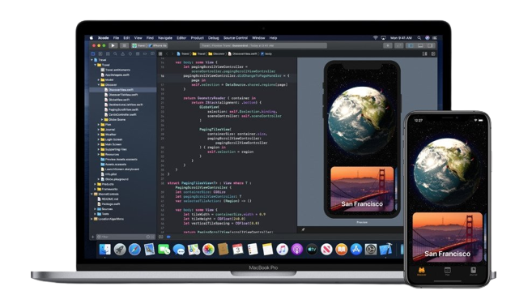
iOS Tools
xCode: Apple’s IDE for macOS, iOS, iPadOS, watchOS and tvOS.
Interface Builder: part of Xcode, allows to create interfaces using a graphical user interface (GUI).
iPhone Simulator: provides ability to test your software on iPhone and iPad.

Slide 19
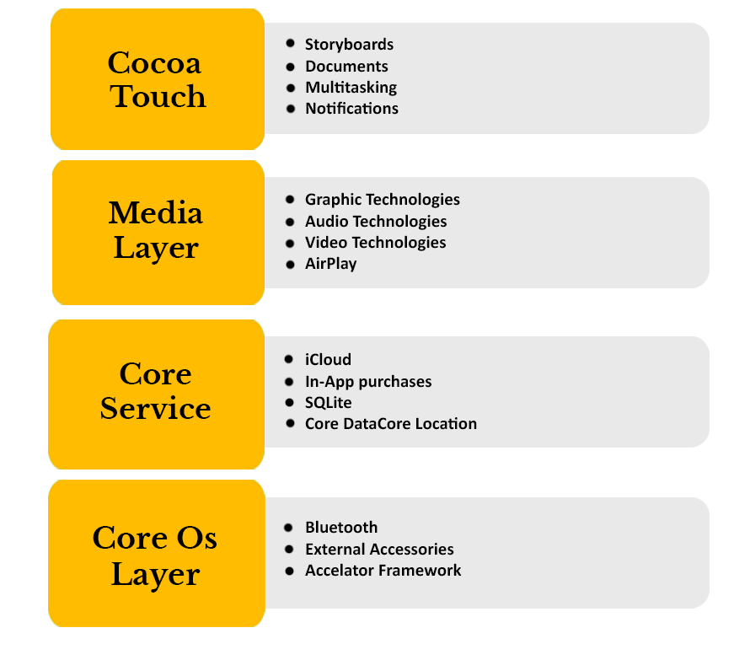
Architecture of iOS
Layered architecture
Lower layer provide basic services on which all applications rely
Higher level-layers provide graphics and interface-related services

Slide 20
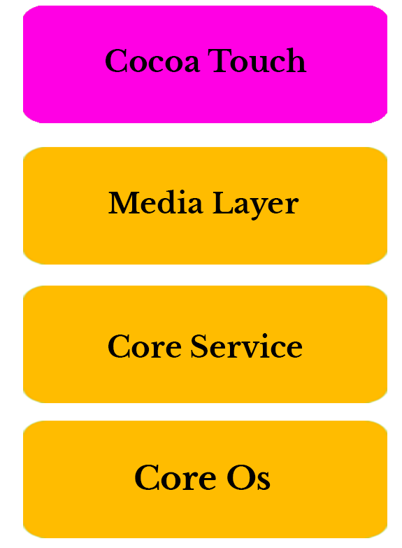
Cocoa Touch Layer
Topmost layer in iOS architecture.
Provides the abstraction of iOS.
Written in objective-C.
Contains frameworks used by native applications like multitasking notification

Slide 21
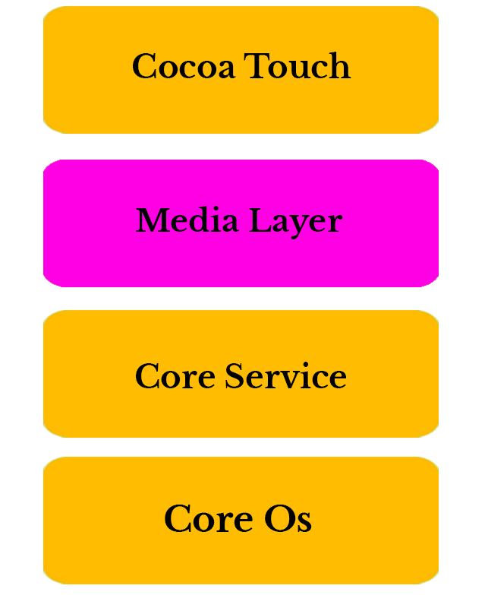
Media Layer
Useful layer provides multimedia services which you can use within your iPhone and other iOS devices.
This layer comprises Graphics, Audio and video

Slide 22
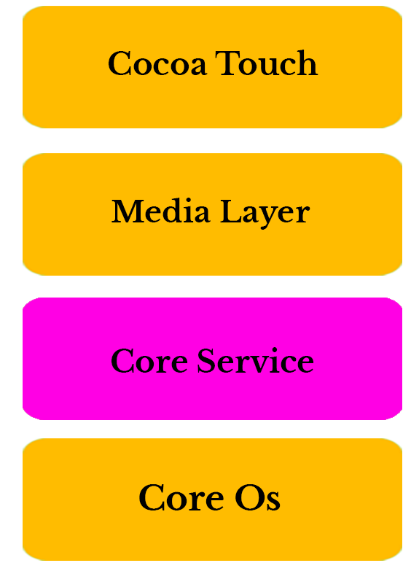
Core Service Layer
Provide features such as IN-APP purchase, cloud storage, SQLite, location

Slide 23
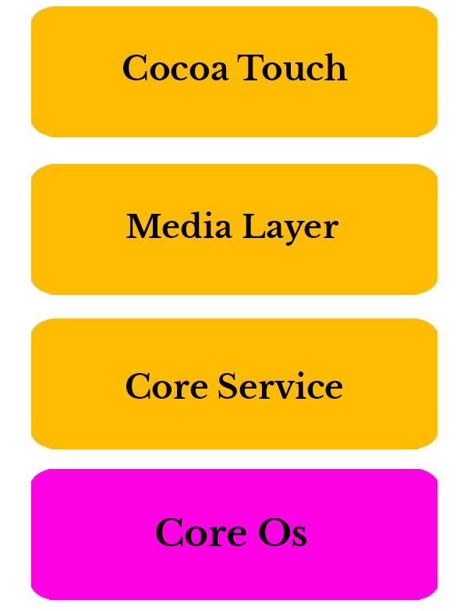
Core OS Layer
Holds low level features on that most other technologies are built upon
Interacts directly on with the hardware

Slide 24

Android
Android => An open source light weight
Project for arm chips.
Developed by => Andy Rubin
Developed in => 2003
Maintained by => Google
Acquired by google => 2007

Slide 25
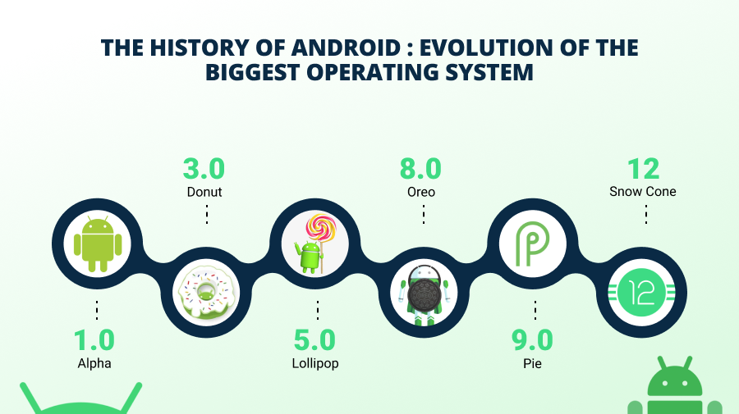

Slide 26
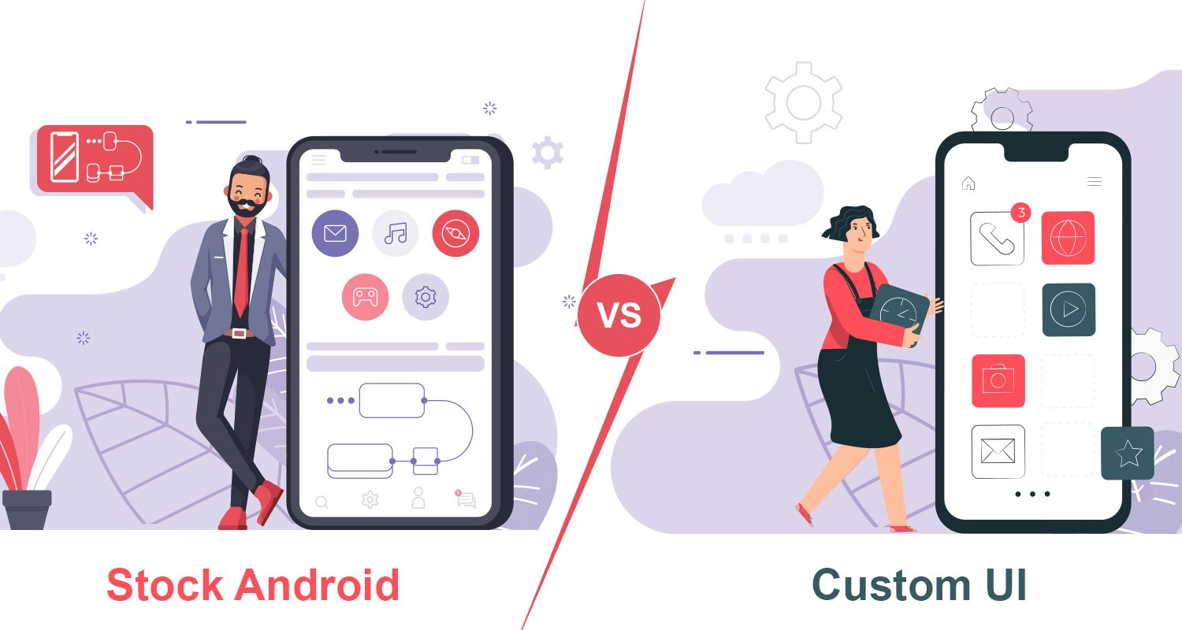
What is stock ,custom-skinned and custom android?

Slide 27
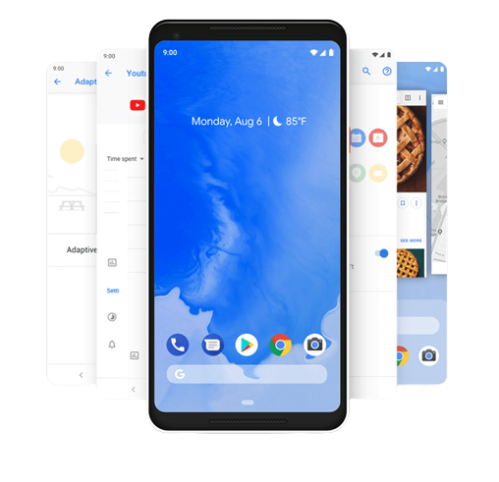
Stock Android ?
The purest version of Android is known as AOSP.
This version of the operating system is its “default” state, with no Google apps, no customizations, and no extra features. Generally, all versions of Android are based on this release.

Slide 28
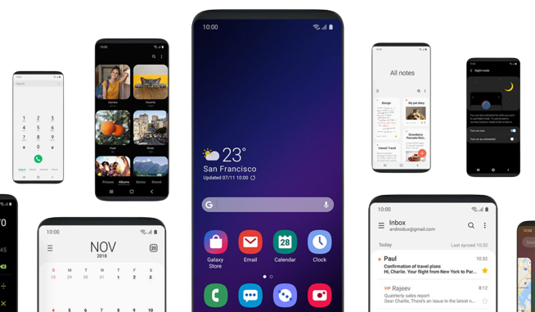
Customs skinned android?
An Android skin is a modified version of stock Android.
Many manufacturers that produce Android devices use their own custom “skins” to make the operating system look unique.

Slide 29

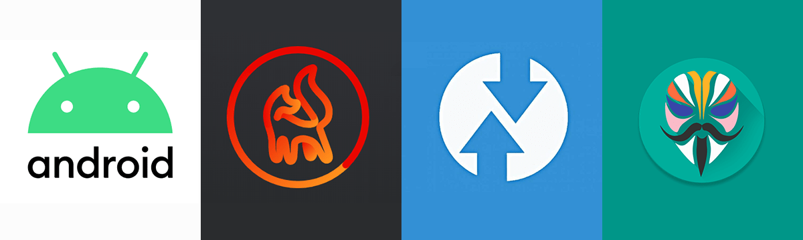
Customs android / customs rom?
Google has made Android open-source, it means the source code of the operating system (OS) itself is available to developers, and anyone can make their own version of Android if they know what they are doing.

Slide 30

How to develop android by own ?
Requirement
Android sources code.
Device tree, kernel tree.
(device drivers)
Basic java knowledge.
A healthy brain.

Slide 31


